Slide 1


DevSecOps Deployment
DevSecOps Deployment: Workflow vs Agent underscores the balance between predictable and a flexible pipeline deployment, Dynamic Agent powered orchestration approach.

Slide 2

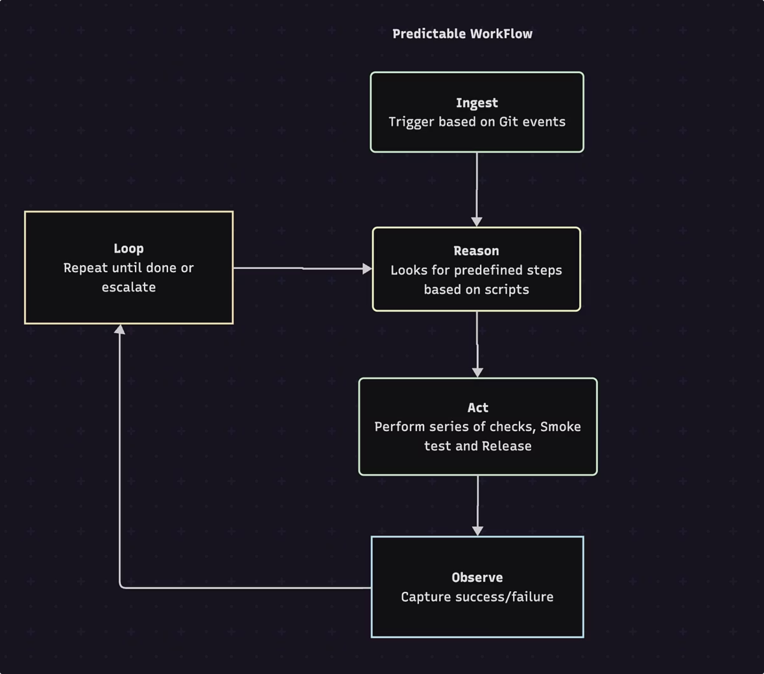




Workflow Design - Predictable DevSecOps Deployment
"Workflows" follow predefined code paths to orchestrate LLMs and tools.
Ingestion
Captures Git events (push/PR) and relevant context.
Predefined Checks and Execution
Performs series of security and quality gates run on code and build.
Release & Deployment
Post preflight passes, Performs round off test then image is published and the workloads are deployed via GitOps.
Drift Detection & Rollout
Ensures that workloads that lives in the cluster always matches Git, auto-fixing any drift.
Notes:
Predefined WorkFlow method would be ideal for environments where workloads are fixed and strraightforward.

Slide 3


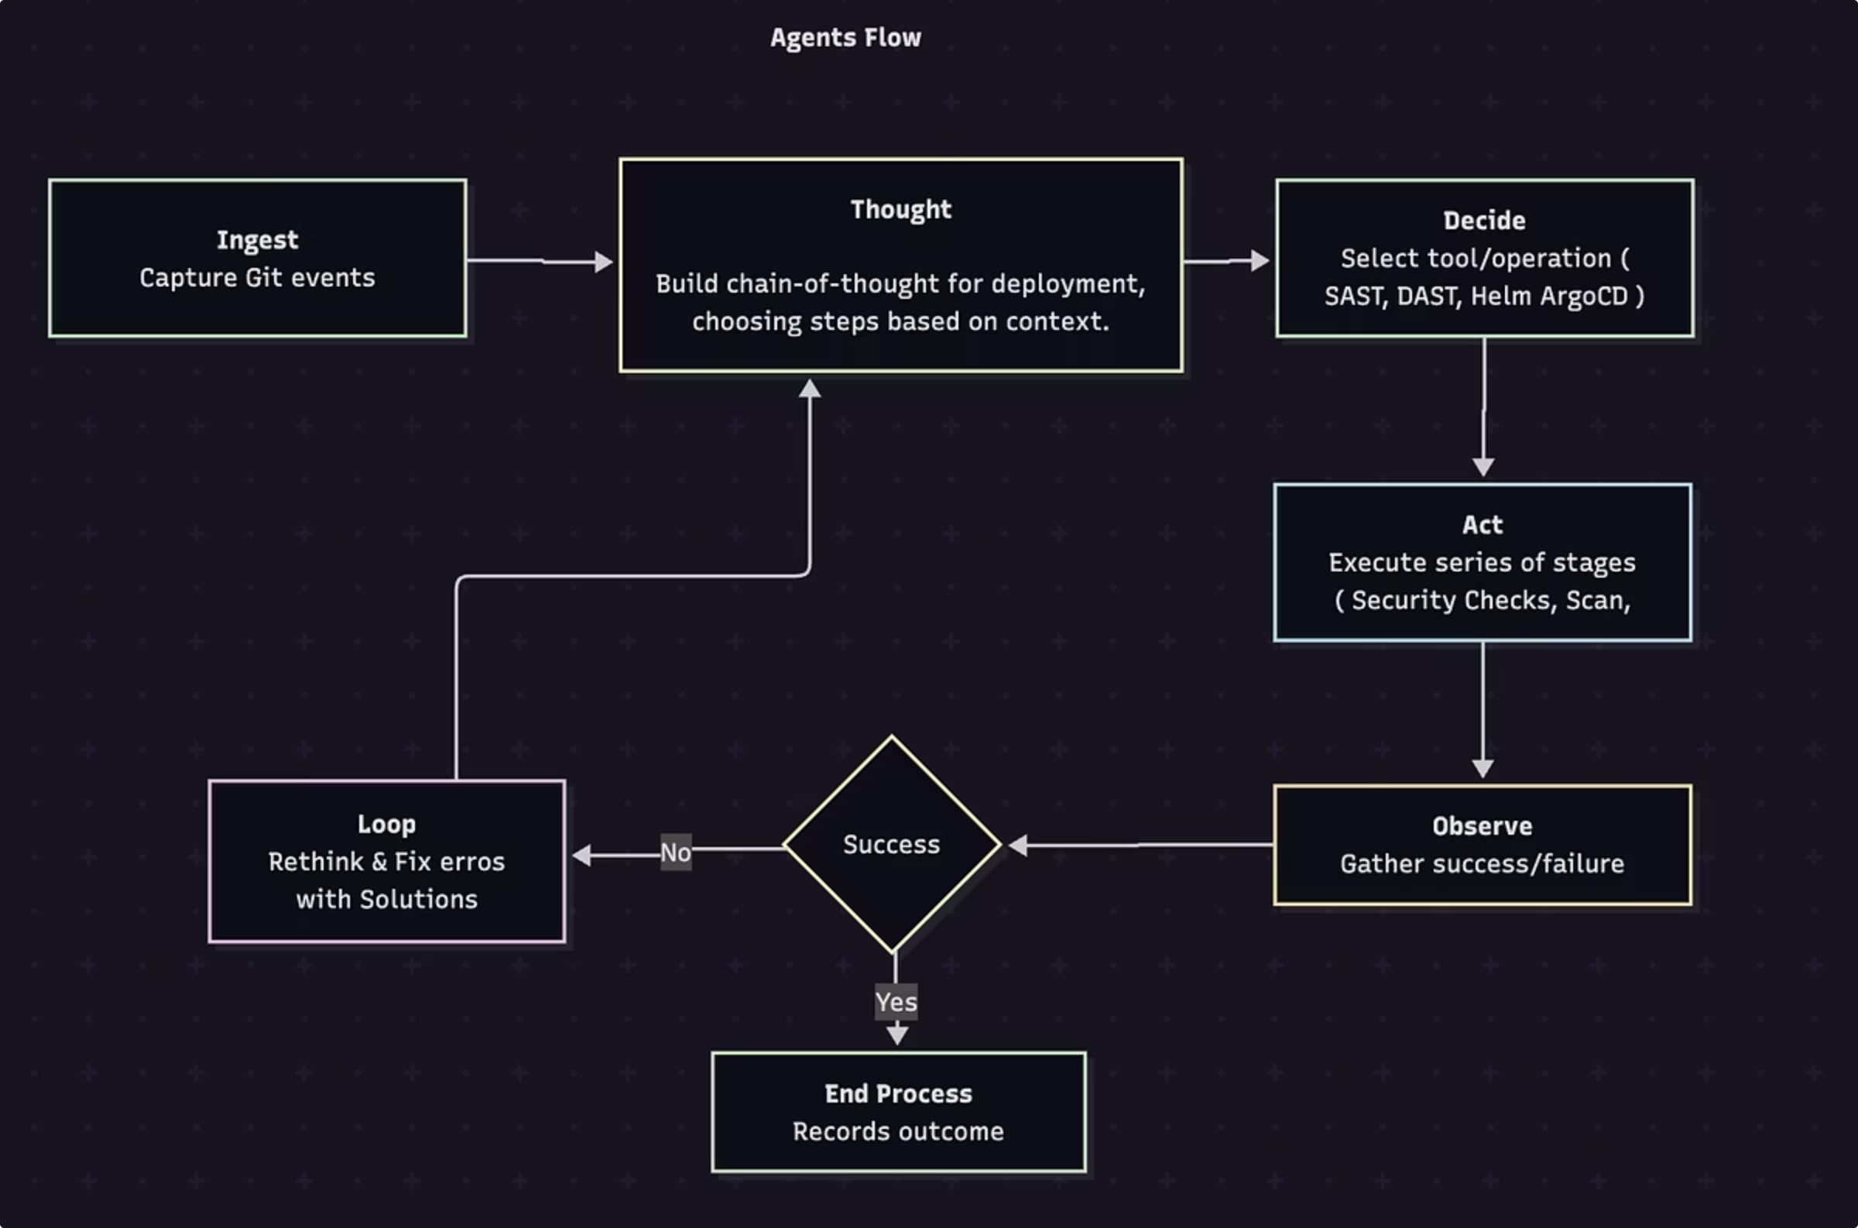




Agent Design - Dynamic deployment
Agents allow LLMs to decide their next steps and tool usage dynamically, maintaining control over task execution.
Ingestion
Captures Git events (push/PR) and relevant context.
Dynamic Tool Invocation
LLM independently outlines the deployment plan, choosing steps based on context.Invoke the appropriate tool for deployment. Eg: SAST, DAST, ArgoCD API calls to deploy.
Release & Deployment
Post preflight passes, Performs round off test then image is published to workloads and deployed via ArgoCD
Problem Solving & Interactive Feedback Loop
Adapt the plan on-the-fly to handle unexpected conditions or config changes without a predefined path.
Observe & Rollout
Ensures that workloads that lives in cluster always matches Git, auto-fixing any drift via metric and logs.

Slide 4
Comparison: DevSecops Deployment Workflow vs Agent
Criteria
Predective WorkFlow
Dynamic Agent
Predictability
Fixed sequence: Every run follows the same sequence of scans, builds, and deploys.
Dynamic Sequence - Scan depth, rollout strategy & retries vary based on real-time context and “reasoning.”
Manifests Updates
CI pipeline (GitLab CI, SAST/DAST/IaC scanners), ArgoCD.
Agents dynamically invokes SAST/DAST/IaC scanners, Terraform/AWS/ArgoCD APIs.
Sync Mechanism
GitOps-driven: Bump image tag in Git → ArgoCD sync → Kubernetes.
Agent can call ArgoCD's API to reconcile instantly.
Recovery
Pipeline reruns, ArgoCD enforces desired state, rollbacks on failure.
Agent observes failures, re-thinks plan, self-heals or escalates.
Flexibility
Low - Follows a strictly defined path.
High - Adapts to unexpected conditions and policy changes.
Best Fit
Stable and compliance-focused environments where consistency is essential with predefined workloads.
Dynamic environments and context-aware security gates, conditional rollouts, and self-remediation.

Slide 5
When to Use Which Approach
Workflow
Agents
Predictable: Executes the same security checks in the same order every time.
Adaptive: Runs deep scans on high-risk changes and quick scans on routine updates.
Auditable: Entire pipeline lives in Git- easy to review and prove compliance.
Autonomous: Attempts self-remediation or escalates failures without human hand-holding.
Simple & Reliable: A straight, linear process that’s trivial to test, debug, and maintain.
Traceable: Logs every reasoning step and action, preserving a rich audit trail.
When to use: Ideal for environments where consistency, repeatability, and straightforward proccess and approaches.
When to use: Best for dynamic environments needing context-driven checks, multi-tool orchestration, and self-healing capabilities.

